Slide 1

Introduction To Java
Confidential
1

Slide 2

Genesis of Java
• The Java language was designed at Sun
Microsystems over a five year period, culminating in its first release in January 1997
• The developers, led by James Gosling, originally set out to build a language for controlling simple home devices with embedding microcomputers.
Confidential
2

Slide 3

Advantages of Java
• Java is object oriented.
• Java works on most platforms. While C/C++ programs are platform specific.
• Java is network enabled. It is trivially simple to write code in Java that works across networks.
Confidential
3

Slide 4

What is JVM?
• It is a hypothetical processor which executes java programs.
• The java compilers produces binary byte code designed to execute on JVM rather than on a PC or Sun Workstation.
• It is abbreviated as Java Virtual Machine.
Confidential
4

Slide 5
Is JVM Platform Independent?
• JVMs are NOT platform independent, whereas java applications are.
Confidential
5

Slide 6
JDK vs JRE
• JDK stands for “Java Development Kit” and JRE stands for “Java Runtime Environment”
• What is the difference between these two?
JRE is a subset of JDK. you need to install the JRE to RUN java applications. you need to install the JDK to DEVELOP and RUN java applications
Confidential
6

Slide 7
Things to remember
• Java is CASE SENSITIVE.
• Every statement in java MUST BE
TERMINATED with a semicolon (;).
• All java programs SHOULD have extension “.java”.
Confidential
7

Slide 8

Diving into Java Language
Confidential
8

Slide 9

Identifiers
• Identifiers, used for names of declared entities such as variables, constants and labels.
• In Java identifiers must start with a letter, followed by letters, digits or both.
• Letters INCLUDE currency symbols($) and underscore ( _ ).
Confidential
9

Slide 10

Keywords
• Keywords are words which have a special meaning within the language.
• Language keywords CANNOT be used as indentifiers
• Some of the keywords are abstract,
boolean, break, class, catch, import, implements, etc..
• null, true and false are literals.
Confidential
10

Slide 11

Types and Literals
• Various types that java supports are boolean, char, byte, short, int, long, float and double.
• Each type has literals, which are the way that constant values of that type are written.
• For example, character “A”, integer 10, boolean true and false all are literals.
Confidential
11

Slide 12

Variables
• A variable is a storage location - something that can hold a value - to which a value can be assigned.
• Various types of variables are member variables, class variables, local variables and parameters.
• “final” modifier declares that the value of the variable is set exactly once and will thereafter always have the same value
Confidential 12

Slide 13
Declaring Variables
• Java requires that you declare every variable before you can use it.
• You can declare the variables in several ways. Often, you declare several at the same time.
int y, m, x //all at once
or one at a time.
int y; //one at a time int m;
int x;
Confidential
13

Slide 14

Declaring Variables (cont…)
• You can also declare the variables as you use them.
int x = 4; int m = 8; int b = -2;
• However, you MUST declare variables by the time you first refer to them.
Confidential
14

Slide 15
Constants
• Constants can be defined by using the final modifier.
• It is a good practice to CAPITALIZE symbols referring to constants.
• Examples
final float PI = 3.1416;
final int NUMBER_OF_DAYS_IN_MONTH = 30;
Confidential
15

Slide 16

Data Types
Type
Contents
boolean
True or false
byte
Signed 8-bit value
short
16-bit integer
int
32-bit integer
long
64-bit integer
float
32-bit floating point
double
64-bit floating point
char
16-bit unicode character
Confidential
16

Slide 17

Data Type Conversions
• Any “wider” data type can have a lower data type assigned directly to it and the promotion to the new type will occur automatically.
• For example, If y is of type float and j is of type int then you can write:
• float y; //y is of type float
• int j; //j is of type int
• y = j; //convert int to float
to promote an integer to a float.
Confidential
17

Slide 18
Data Type Conversions (cont…)
• You can reduce a wider type to a narrower type using by casting it. You do this by putting the data type name in parentheses and putting this name in front of the value you wish to convert:
• For example,
j = (int)y; //convert float to integer
Confidential
18

Slide 19

Boolean Data Type
• Boolean variables can only take on the values represented by the reserved words true and false.
Unlike C, you cannot assign numeric values to a boolean variable and you cannot convert between boolean and any other type.
Confidential
19

Slide 20

Numeric Data Types
• Any number you type into your program is automatically of type int if it has no fractional part or of type double if it does.
• For example in a program if a number, say
5.5 is used then it will be of double data type by default.
Confidential
20

Slide 21

Numeric Data Types (cont…)
• If you want to indicate that it is a different type, you can use various suffix and prefix characters to indicate what you had in mind.
• For example,
float loan = 1.23f; //float long pig = 45L; //long
long color = 0x12345; //hexadecimal
Confidential
21

Slide 22
Brain Teaser - 1
• Will the below line compile?
float f = 10.0;
Confidential
22

Slide 23

Simple Java Program
import java.io.*
public class Add2 {
public static void main(String argv[ ]) { double a, b, c;
a = 1.75;
b = 3.46; c = a + b;
// print out sum
System.out.println("sum = " + c); }
}
Output : sum = 5.21
Confidential
23

Slide 24

Class Definition
• Every program module must contain one or more classes.
• The class and each function within the class is surrounded by braces ({ }).
• Like most other languages the equals sign is used to represent assignment of data.
Confidential
24

Slide 25

String concatenation
• You can use the “+” sign to combine two strings. The string “sum =” is concatenated with the string representation of the double precision variable c.
Confidential
25

Slide 26
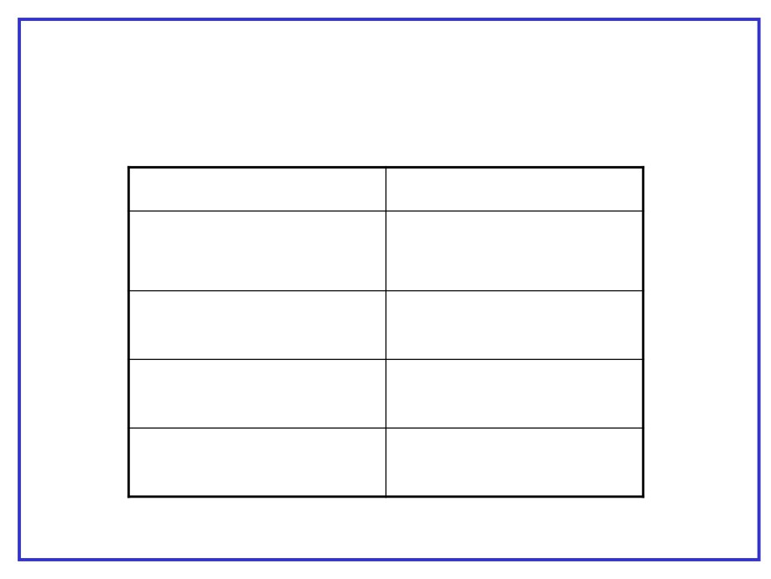
Arithmetic Operators
+
Addition
-
Subtraction, Unary
Minus
Multiplication
/
Division
%
Modulus
Confidential
26

Slide 27

Assignment Operators
=
Assignment
+=
Compound assignment
-=
*=
/=
etc
Confidential
27

Slide 28

Increment & Decrement Operators
• Java allows you to express incrementing
and decrementing of integer variables using the “++” and “--” operators.
• For example
i = 5; j = 10;
x= i++
//x = 5, then i = 6
y = --j; //y = 9 , j = 9;
Confidential
28

Slide 29

Control structures
Confidential
29

Slide 30
Making decisions in Java
• The familiar if-then-else of Visual Basic has its analog in Java. Note that in Java, however, we do not use the “then” keyword. For Example,
if ( y > 0 ) z = x / y;
• Parentheses around the condition are REQUIRED in Java.
Confidential
30

Slide 31

Making decisions in java (cont…)
• If you want to have several statements as part of the condition, you must enclose them in braces:
if (y > 0) {
z = x / y;
System.out.println(“z = “ + z);
}
Confidential
31

Slide 32

Comparison Operators
Java
Meaning
>
Greater than
<
Less than
= =
Is equal to
!=
Is not equal to
>=
Greater than or equal to
<=
Less than or equal to
!
Not
Note :- All of these operators return boolean results
Confidential
32

Slide 33
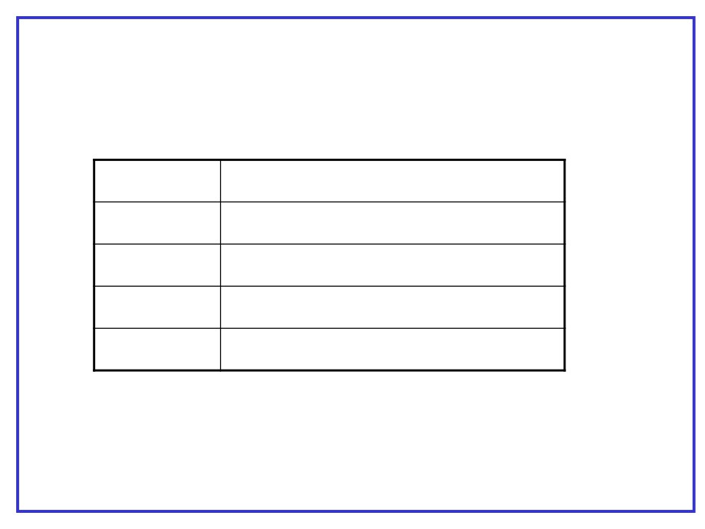
Logical operators
Operator
Meaning
&
Logical AND
|
Logical OR
&&
Shortcut Logical AND
||
Shortcut Logical OR
Confidential
33

Slide 34

switch statement
switch(expression) {
case constant : statements case constant : statements
----
----
default : statements }
Confidential
34

Slide 35

switch statement - example
switch(number) {
case 1: System.out.println(“One”); break;
case 2: System.out.println(“Two”); break;
case 3: System.out.println(“Three”); break;
default : System.out.println(“Invalid”); }
Confidential
35

Slide 36
Brain Teaser
• What is the output of the below line?
int x = 0;
If (x = 0) {
System.out.println(“X is Zero”);
}
Confidential
36

Slide 37

Loops
while(boolean-expression) statement
do
statement
while(boolean-expression);
for(initialization; boolean-expression; step) statement
Confidential
37

Slide 38
Loops - examples
public class WhileDemo {
public static void main(String[] args) {
String copyFromMe = “This is a sample string"; StringBuffer copyToMe = new StringBuffer(); int i = 0;
char c = copyFromMe.charAt(i);
while (c != 'g') {
copyToMe.append(c);
c = copyFromMe.charAt(++i); }
System.out.println(copyToMe); }
Confidential
38

Slide 39
Loops - examples
public static void main(String[] args) {
int[] arrayOfInts = { 32, 87, 3, 589, 12, 1076, 2000, 8, 622, 127 };
for (int i = 0; i < arrayOfInts.length; i++) { System.out.print(arrayOfInts[i] + " "); }
System.out.print(“\n”); }
}
Confidential
39

Slide 40

break and continue
• You can also control the flow of the loop inside the body of any of the iteration statements by using break and continue
• break quits the loop without executing the rest of the statements in the loop
• continue stops the execution of the current iteration and goes back to the beginning of the loop to begin the next iteration
• For nested loops, labels can be used along with these statements to specify the loop
Confidential
40

Slide 41
continue / break - examples
outer:
for(; true ;) { inner:
for(; i < 10; i++) {
System.out.println("i = " + i); if(i == 2) continue;
if(i == 3) break;
if(i == 7) continue outer; if(i == 8) break outer; }
}
Confidential
41

Slide 42
Classes and Objects
Confidential
42

Slide 43
Agenda
✓Classes ✓Objects ✓Fields
✓Constructors ✓Methods
Confidential
43

Slide 44

Class
• It is a basic unit in java programming language.
• It provides a structure for objects.
• Contract - A combination of methods, data and semantics.
Confidential
44

Slide 45
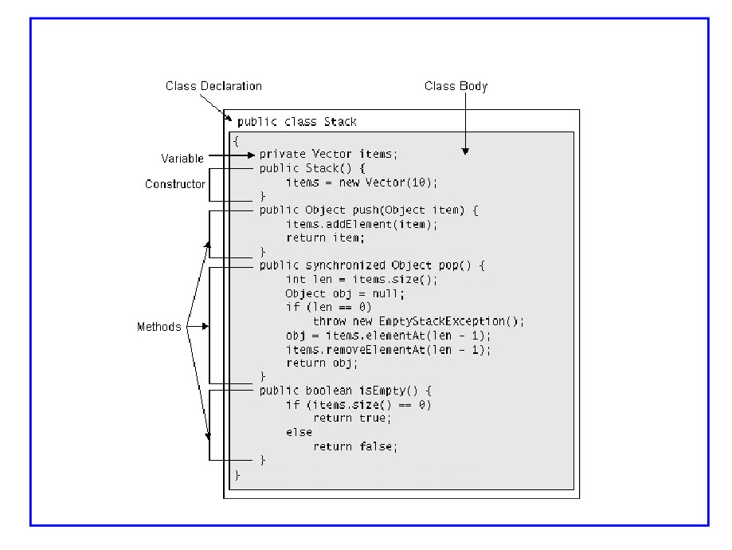
class
Confidential
45

Slide 46
Simple class
class BankAccount {
private double balance = 0.0; }
Confidential
46

Slide 47
Class Members
1. Fields
2. Methods
3. Classes - Nested classes
4. Interfaces - Nested interfaces
Confidential
47

Slide 48

Fields
• Class variables are called fields.
• Fields are data variables associated with a class and its objects.
• Instance variables - associated with objects
• Static variables - associated with class
Confidential
48

Slide 49
Field Initialization
• When a field is declared it can be initialized by assigning it a valued of the corresponding type
➢ double zero = 0.0; // constant
➢ double sum = 4.5 + 3.7; // constant expression ➢ double zeroCopy = zero; // field
➢ double rootTwo = Math.sqrt(2); // method invocation ➢ double someVal = sum + 2 * Math.sqrt(rootTwo)
Confidential
49

Slide 50
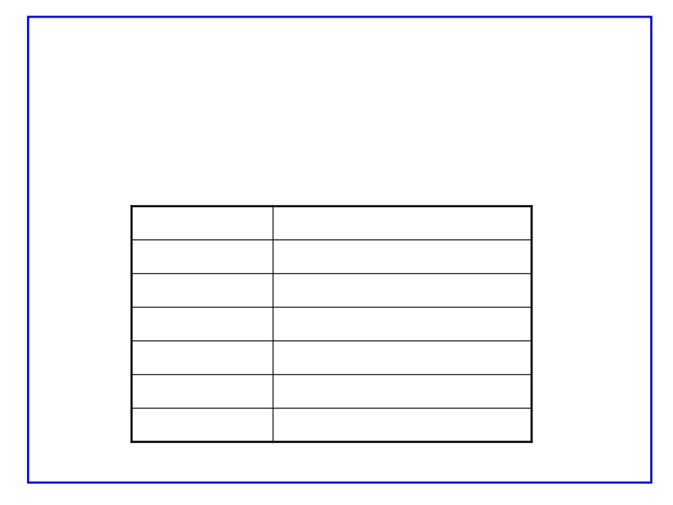
Field Initialization contd..
• If a field is not initialized a default initial value is assigned to it depending on its type.
Type
Default value
boolean
false
char
‘\u0000’
int types
0
float
0.0f
double
0.0
Object ref
null
Confidential
50

Slide 51
Final fields
• A final variable is one whose value cannot be changed after it has been initialized.
• Ex:
final double PI = 3.141592;
Confidential
51

Slide 52
Methods
• Methods also are members of a class
• Method should have a type
• Type of a method is the type of data it returns
• If the method does not return a value its type is void
•
‘this’ can be used to refer instance variable
explicitly
Confidential
52

Slide 53
Static members
• Variables shared by all objects of a class are called static fields or class variables.
static int nextID;
• But, when accessed externally it must be accessed via class name.
Ex: System.out
• Methods also can be static
Confidential
53

Slide 54

Access control
• It provides a way to who has access to what members of a class. ➢ private - accessible only in the class itself.
➢ package - accessible in
• subclasses
• class itself
➢ protected - accessible in
• subclasses,
• classes in same package,
• the class itself.
➢ public - accessible
• anywhere the class is accessible.
Confidential
54

Slide 55
Creating Objects
• Object of a class is created using the keyword - new
• Ex:-
BankAccount anAccount = new BankAccount() anAccount.balance = 1000.00;
• You never delete objects. JVM manages memory for you using garbage collection.
Confidential
55

Slide 56
Constructors
• Constructors are blocks of statements that can be used to initialize an object.
• Constructors have the same name as the class they initialize.
• Constructors take zero or more arguments.
Confidential
56

Slide 57
Constructors (contd)
EX:
class BankAccount {
double balance = 0.0
BankAccount(double initialBalance) { balance = initialBalance
}
}
Using constructor to create objects:
BankAccount anAccount = new BankAccount(1000.00);
Confidential
57

Slide 58

Constructors (contd)
• All Java classes have constructors that are used to initialize a new object of that type
• A constructor has the SAME NAME as the class
• A constructor DOESNOT have return type.
• For example, a no argument constructor for Stack class can be
public Stack() {
items = new Vector(10); }
Confidential
58

Slide 59

Constructors (contd)
• Java supports name overloading for constructors so that a class can have any number of constructors, all of which have the same name
• For example, constructors for the stack classes can be
- Public Stack() // no argument ctor
- Public Stack(int initialSize) // 1 argument ctor
Confidential
59

Slide 60

Default Constructor
• When writing your own class, you DON’T HAVE to provide constructors for it
• The default no argument constructor is
automatically provided by the runtime system for any class that contains no constructors
• If a constructor with arguments is provided,
default constructor is not automatically created by runtime system
Confidential
60

Slide 61
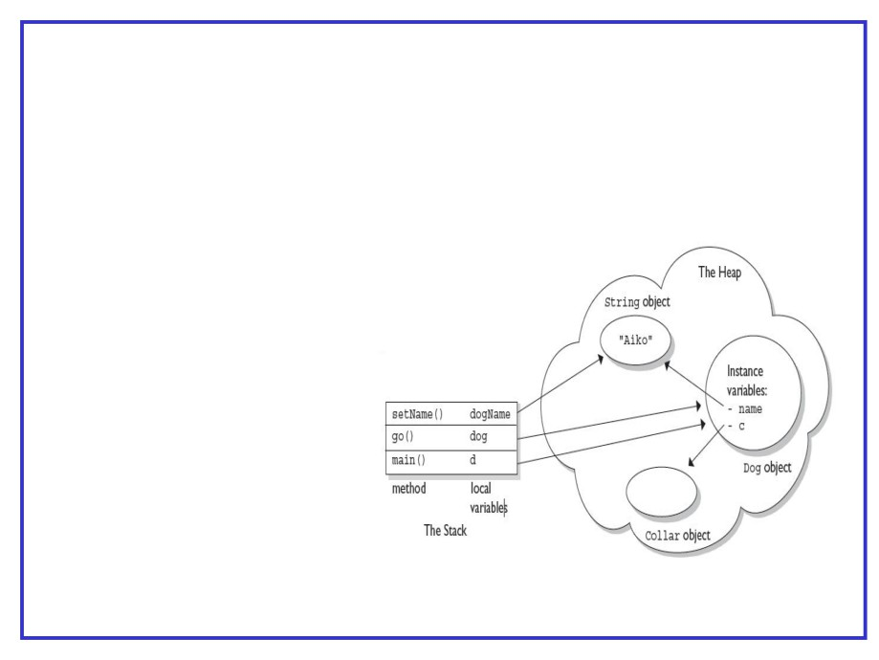
Object diagram
class Collar { }
class Dog { Collar c;
String name;
public static void main(String [ ] a){ Dog d;
d = new Dog(); d.go(d);
}
void go(Dog dog) {
c = new Collar();
dog.setName(“Aiko"); }
void setName(String dogName) { name = dogName;
}
}
Confidential
61

Slide 62
Brain Teaser
• What is the output of the following code?
Public class Echo {
Public Echo(String str) { System.out.println(str); }
Public static void main(String args[]) { Echo obj1 = new Echo(“Hello”); Echo obj2 = new Echo(“World”); Echo obj3 = new Echo(); }
}
Confidential
62

Slide 63
Brain Teaser 1
class Test { }
Does the above code compile and execute?
Confidential
63

Slide 64
Brain Teaser 2
class Test {
final int value = 3; Test() {
value = 10; }
}
Does the code compile and run?
Confidential
64

Slide 65
Life Cycle Of an Object
● A class provides the blueprint for objects ● Variable of class type is object reference
● Unless assigned with object reference, variable value is null
Point origin_one = new Point(23, 94);
Rectangle rect_one = new Rectangle(origin_one, 100, 200);
● Referencing an Object's Variables (instance variables) objectReference.variableName
● Calling an Object's Methods (instance methods) objectReference.methodName(argumentList);
Confidential
65

Slide 66
Life Cycle Of an Object
Cleaning Up Unused Objects
- The Java runtime environment deletes objects when it determines that they are no longer used. This process is called garbage collection.
- An object is eligible for garbage collection when there are no more references to that object.
- We can explicitly drop an object reference by setting the variable to the special value null
Garbage Collector
- JRE has a garbage collector that periodically frees the memory used by objects that are no longer referenced.
Confidential
66

Slide 67

Arrays
• Arrays provide ordered collections of elements.
• Components of array can be primitive types or
references to objects, including references to other arrays.
• Arrays themselves are objects and extend the class Object
• Examples:
int[] x = new int[3];
int y[] = new int[3];
Confidential
67

Slide 68
Arrays (cont…)
• An ArrayIndexOutOfBoundsException is thrown if the index is out of bounds.
• The index expression must be of type int
• Implicit length variable used to know the size of the array
• An array with length zero is said to be an empty array.
Confidential
68

Slide 69
Arrays - example
public class ArrayTest {
public static void main(String[] args) { int a1[] = {10,34,56,23,67,87}; int a2[];// value is null int a3[] = new int[5];
a2 = a1; // a1 and a2 hold same array /* use length to know the size of the array */
for(int i=0;i<a1.length;i++)
System.out.println(a1[i]);
}
Confidential
69

Slide 70
Array of objects
• Array of objects is array of references to the objects as shown in this
example
public class ArrayOfStringsDemo {
public static void main(String[] args) { Test b[] = new Test[5];
Test a[] = { new Test(“Ramana”), new Test(“Surender”), new Test(“Hiresh”), new Test(“Haritha”) };
for (int i = 0; i < a.length; i++) a[i].show(); }
}
public class Test {
public Test(String s) { name = s;
}
public void show() {
System.out.println(name); }
}
Confidential
70

Slide 71
Multi dimensional arrays
➢ Multidimensional arrays are arrays of refences to arrays
String[][] cartoons = {
{ "Flintstones", "Fred", "Wilma", "Pebbles", "Dino" }, { "Rubbles", "Barney", "Betty", "Bam Bam" }, { "Jetsons", "George", "Jane", "Elroy", "Judy", "Rosie", "Astro" },
{ "Scooby Doo Gang", "Scooby Doo", "Shaggy", "Velma", "Fred", "Daphne" }
};
Test x[][] = new Test[5][10];
int y[][] = new int[3][];
y[0] = new int[5];
y[1] = new int[10]; y[2] = new int[2];
Confidential
71

Slide 72
String objects
Confidential
72

Slide 73
String
• The String class represents character strings
• All string literals in Java programs, such as "abc", are implemented as instances of this class.
• Strings are constant; their values cannot be changed after they are created
• The class String includes methods for examining
individual characters of the sequence, for comparing
strings, for searching strings, for extracting substrings, and for creating a copy of a string with all characters translated to uppercase or to lowercase
• The Java language provides special support for the string concatenation operator ( + ), and for conversion of other
objects to strings.
Confidential
73

Slide 74
String (contd)
• Ways of creating String objects :
String s = “Hello”
String s = new String(“hello”);
char[ ] ch = { ‘a’,’b’,’c’}; String s = new String(ch);
Confidential
74

Slide 75

String methods
Some of the methods
char charAt(int index) String concat(String) boolean equals(Object)
boolean equalsIgnoreCase(String) int indexOf(String str)
int length()
String replace(char old, char new)
String substring(int begin, int end) // begin to end - 1 String toLowerCase()
String toUpperCase() String trim()
static String valueOf(alltypes)
Confidential
75

Slide 76
StringBuffer & StringBuilder
Both classes represent mutable string objects Both have same methods
StringBuffer is threadsafe, StringBuilder is not
Constructors
StringBuilder( ) // initial capacity 16 StringBuilder(int capacity)
StringBuilder(String st)
//create with capacity 16 + length of st
Confidential
76

Slide 77
StringBuffer & StringBuilder
Some methods
StringBuilder append(alltypes) int capacity( )
char charAt(int index) int capacity()
StringBuilder delete(int start, int end) StringBuilder deleteCharAt(int index) int indexOf(String)
//start to end - 1
StringBuilder insert(int offset, alltypes) int length( )
StringBuilder replace(int start, int end, String new) StringBuffer reverse( )
Confidential
77

Slide 78
Extending classes
Confidential
78

Slide 79
Agenda
✓ Inheritance ✓ Overriding ✓ super
✓ Hiding Members
Confidential
79

Slide 80

INHERITANCE
• Inheritance denotes Specialization.
• A subclass is a class that extends another class. A subclass inherits state and behavior from all of its ancestors (a.k.a super class(es)).
• A subclass inherits variables and methods from its superclass and all of its ancestors. The subclass can use these members as is, or it can hide the member variables or override the methods.
Confidential
80

Slide 81
Members inherited in subclass
• RULE 1: Subclasses inherit those super class members declared as public or protected.
• RULE 2: Subclasses inherit those superclass
members declared with no access specifier as long as the subclass is in the same package as the superclass.
Confidential
81

Slide 82
Members inherited in subclass (cont)
• RULE 3: Subclasses DON’T inherit a super class's members if the subclass declares a member with same name
• In the case of member variables, the member
variable in the subclass hides the one in the
superclass. In the case of methods, the method in the subclass overrides the one in the superclass with same name and arguements.
Confidential
82

Slide 83
Constructors in inheritence
• While creating subclass objects super class default constructor is automatically invoked
• To invoke arguemented constructor of super class use super() with arguments
• super() should be first statement in subclass constructor
Confidential
83

Slide 84

Overriding
• Overriding a method means replacing the
superclass’s implementation of a method with one of your own. The signature must be identical
• When a method is overridden it means both the signature and return type are SAME as in the superclass.
• If two methods differ only in return type it is an ERROR and the compiler will reject the class.
Confidential
84

Slide 85
Overriding (cont…)
• Overriding methods can have their own access specifiers. A subclass can change the access of a superclass’s methods, but ONLY to provide MORE access.
• For example
class Base {
Protected void show() { }
}
Class Derived extends Base{
Public void show() { }
//this is valid
}
Confidential
85

Slide 86

Overriding (cont…)
• The Overriding method can be made final but not the method being overridden.
• Overriding method’s throws clause CAN BE
different from that of the superclass method’s as long as every exception type listed in the overriding method is the same or a subtype of the exceptions listed in the superclass’s method.
• An overriding method can have NO throws clause though the method in superclass has.
Confidential
86

Slide 87

Abstract methods & classes
• Methods whose design is not complete are called abstract methods
• Ex: public abstract void printIt(intx, String y);
• Class having abstract methods should be declared as abstract class
• Abstract class cannot be instantiated (cannot create objects)
• Abstract classes are for subclassing
• A class declared as abstract need not have abstract methods
Confidential
87

Slide 88
Hiding Fields
• Fields cannot be overridden. They CAN ONLY be HIDDEN.
• If a member name in the subclass is same as that of a member in superclass then the superclass’s member is said to be hidden in the subclass.
• You must use super or any other reference of your superclass’s type to access it.
Confidential
88

Slide 89
Brain Teaser
Class Supershow {
public String str = “superstr”; public void show() {
System.out.println(“super.show :” + str); }
}
Class SubShow extends Supershow { public String str = “substr”; public void show() {
System.out.println(“sub.show :” + str); }
public static void main(String[] args) { SubShow derived = new SubShow(); Supershow base = derived;
base.show(); derived.show();
System.out.println(“super.str :” + base.str);
System.out.println(“sub.str : “ + derived.str); }
}
Confidential
89

Slide 90
final class
• Class declared as final cannot be extended
• final class cannot have abstract methods
• Ex:
public final class LastOne {
---------
---------
}
Confidential
90

Slide 91
Interfaces
x
Confidential
91

Slide 92

Agenda
1. Introduction
2. Declaration
3. Extending interfaces
4. Working with interfaces
5. Marker interfaces
Confidential
92

Slide 93
Introduction
• The fundamental unit of OO design is the
type.
• Interfaces define types in an abstract form as a collection of methods.
• Interfaces contain no implementation and you cannot create instances of an interface.
• Classes can expand their own types by implementing interfaces.
Confidential
93

Slide 94

Introduction (contd…)
• Classes can implement more than one interface.
• In a given class, the classes that are
extended and the interfaces that are
implemented are collectively called the supertypes, the new class is a subtype.
Confidential
94

Slide 95

Interface example
• An example of a simple interface :
public interface Comparable { int compareTo(Object o); }
Confidential
95

Slide 96

Declarations
• An interface is declared using the keyword
interface, giving the interface a name and listing the interface members between braces.
• An interface can have
1. Constants
2. Methods (only signature)
• Interface members are implicitly public.
Confidential
96

Slide 97
Interface constants
• An interface can declare named constants.
• These constants are implicitly public, static, and final.
• interface Verbose
{
int SILENT = 0; int NORMAL = 1; int VERBOSE = 3; }
Confidential 97

Slide 98
Interface methods
• The methods declared in an interface are implicitly abstract and public, no other modifiers are permitted
• Methods cannot be static - because static methods cannot be abstract.
Confidential
98

Slide 99

Extending interfaces
• Interfaces can be extended using the extends keyword.
public interface SerializableRunnable extends Serializable, Runnable {
//………….
}
• The interfaces that are extended are the superinterfaces and the new interface is a subinterface
Confidential
99

Slide 100
Hiding constants
• If an interface declares a constant of the same
name as an inherited constant, regardless of their types, then the new constant hides the inherited one.
• interface X {
int val = 1;
}
interface Y extends X { int val = 2;
int sum = val + A.val; }
Confidential
100

Slide 101

Overloading and overriding methods
• A subinterface inherits all of the methods declared in its superinterfaces.
• Override - declared method in subinterface with the same signature and return type.
• If a declared method differs only in return type from an inherited method, then an error occurs.
Confidential
101

Slide 102
Implementing interfaces
• A class can implement one or more interfaces using implements keyword
• public class XXXX implements Comparable {
public int compareTo(Object o ) // Implementation details }
Confidential
102

Slide 103
Marker interfaces
• Some interfaces do not declare any methods. These are marker interfaces.
• Marker interfaces simply mark a class as having some general property.
• Examples of marker interfaces:
- Serializable
- Cloneable
- java.rmi.Remote
Confidential
103

Slide 104

Packages
• Packages are convenient ways of grouping related classes according to their functionality, usability as well as category they should belong to.
• Classes under different packages CAN HAVE same names.
• Packaging help us to avoid class name collision
when we use the same class name as that of others
Confidential
104

Slide 105

How to create Packages?
1. Suppose we have a file called HelloWorld.java, and we want to put this file in a package world then add the package definition in the top of the file as shown below…
// only comment are allowed before this definition package world;
public class HelloWorld { //…
}
2. Create subdirectories to represent package hierachy of the class. In our case, we have the world package, which requires only one directory. So, we create a directory world and put our HelloWorld.java into it.
Confidential
105

Slide 106

How to use Packages?
• There are 2 ways in order to use the public classes stored in package.
1. Declare the fully-qualified class name. For example,
world.HelloWorld hw = new world.HelloWorld();
world.moon.HelloMoon hm = new world.moon.HelloMoon(); String holeName = helloMoon.getHoleName();
2. Use an "import" keyword:
import world.*;
import world.moon.*;
HelloWorld helloWorld = new HelloWorld(); HelloMoon helloMoon = new HelloMoon();
Confidential
106

Slide 107
CLASSPATH
• Environment variable CLASSPATH should be set to search for packages
• Specify a series of folders in classpath
• Ex:
Set CLASSPATH=c:\;d:\javaprg;c:\test\classes
• Packages / classes are searched for in c:\ , d:\javaprg and c:\test\classes in that order
• Classes with no package statement belong to default package
Confidential
107

Slide 108
Points to Note
• Classpath not required for JDK classes
• While using JDK classes, package to which the class belongs should be identified for import statement
• java.lang package classes need not be imported
• Object, String, StringBuffer, Runtime, System classes and wrapper classes belong to java.lang package
Confidential
108

Slide 109
Exceptions
x
Confidential
109

Slide 110

Exception Handling
• Exception is an event that occurs during the execution of a program that disrupts the normal flow of instructions
• Exceptions can occur when
- The file you try to open does not exist
- The network connection is disrupted
- Operands being manipulated are out of prescribed ranges
- The class files you are interested in loading are missing
Confidential
110

Slide 111
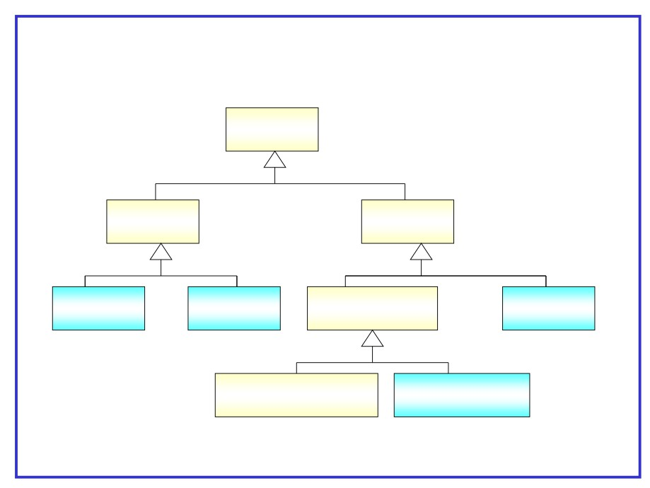
Exception class hirarchy
Throwable
(from lang)
Error
Exception
(from lang)
(from lang)
ThreadDeath
Linkage Death
Runtime Exception
SQL Exception
(from lang)
(from lang)
(from lang)
(from sql)
IndexOutOfBounds Exception
ArithmeticException
(from lang)
(from lang)
Confidential
111

Slide 112

Exception Handling
• Checked Exceptions
- Extends the java.lang.Exception class.
- Needs to be caught or specified.
• Unchecked Exceptions
- Extends the java.lang.RuntimeException class
- Need not be caught or specified.
Confidential
112

Slide 113

Exception Handling
● Methods should either catch or specify all checked exceptions that can be thrown within the scope of that method
● A method can catch an exception by providing an exception handler for that type of exception
● If a method chooses not to catch an exception, the method must specify that it can throw that exception
● Callers of a method must know about the exceptions that a method can throw
Confidential
113

Slide 114

Dealing with Exceptions
•
Three components of an exception handler
try, catch, and finally blocks
try Block
•
Enclose the statements that might throw an exception within a try block
•
Defines the scope of any exception handlers
catch Block
• Associate exception handlers with a try block by providing one or more
catch blocks directly after the try block
finally Block
•
Allows the method to clean up after itself regardless of what happens
within the try block
Confidential
114

Slide 115
Exceptions - example
public void writeList() {
PrintWriter out = null; try {
System.out.println("Entering try statement"); out = new PrintWriter(
new FileWriter("OutFile.txt"));
for (int i = 0; i < size; i++)
out.println("Value at: " + i + " = " + victor.elementAt(i));
} catch (ArrayIndexOutOfBoundsException e) {
System.out.println(“Array referror " + e.getMessage()); } catch (IOException e) {
System.out.println(“IOException: " + e.getMessage()); }
finally {
if (out != null) out.close(); }
}
Confidential
115

Slide 116
Specifying the Exceptions Thrown by a Method
➢ To let a method transfer the exception to the caller, specify throws ➢ Caller is responsible to handle this exception
Ex:
public void writeList() throws IOException { PrintWriter pw =
new PrintWriter(new FileWriter("File.txt")); for (int i = 0; i < size; i++)
pw.println(b[i]);
pw.close();
}
Confidential
116

Slide 117
Defining Exceptions
throw statement
Before you can catch an exception, some Java code somewhere must throw one
throw someThrowableObject;
Throwable objects should be subclass of the Throwable class
Confidential
117

Slide 118
Defining Exceptions - example
public class ApplicationException extends Exception{ public ApplicationException(String msg){
super(msg);
}
}
public void readFile(String fileName) throws ApplicationException {
try {
FileInputStream fis = new FileInputStream(fileName); …………………….
}
catch (FileNotFoundException e) {
throw new ApplicationException(“File Not Found”,
e);
}
}
Confidential 118

Slide 119
Classes of java.lang package
x
Confidential
119

Slide 120
Object class
● Every java class extends Object class either directly or indirectly
● Object class provides useful methods required in every class ● Some of the methods need to be overwritten
● If a class does not extend any class, it automatically extends Object
● Every java objetc is instanceOf Object
Confidential
120

Slide 121
Object class
Some Object class methods
boolean equals (Object obj)
Decides whether two objects are meaningfully equivalent.
void finalize( )
Called by garbage collector when the garbage collector sees that the object cannot be referenced
int hashCode( )
Returns a hashcode int value for an object, so that the object can be used in Collection classes that use hashing, including Hashtable, HashMap, and HashSet
String toString( )
Returns a “text representation” of the object
Confidential
121

Slide 122
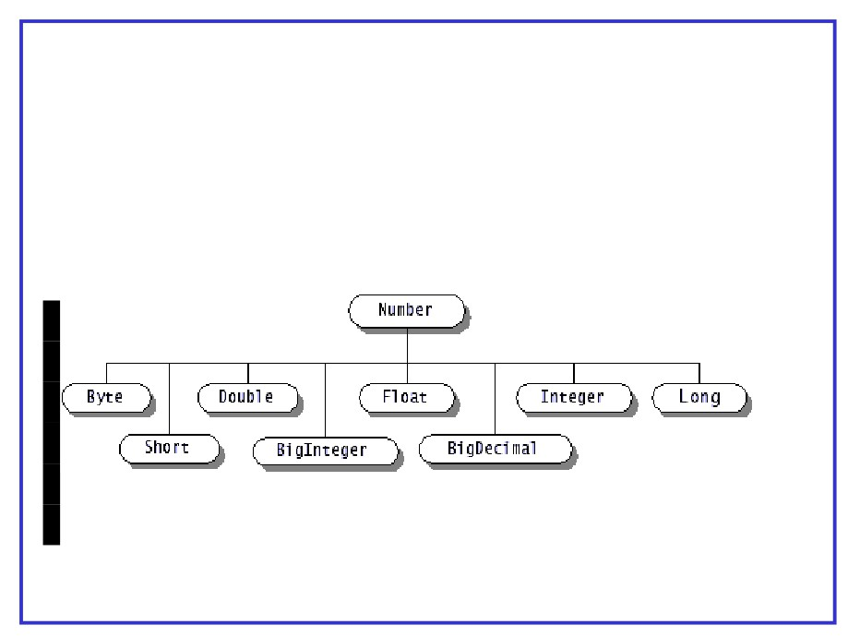
Wrapper classes
● Wrapper classes available to create objects for all primitive types
● These classes provide methods to convert wrap primitive types and also convert back to primitives
● Also available, Boolean and Character classes
Confidential
122

Slide 123
Wrapper classes
● Designed to convert primitives into objects ● Wrapper objects are immutable
● provide functions for conversion of primitives to/from String objects to different bases
● All wrapper class names map to primitives they represent except Integer and Character
● Byte, Short, Integer, Long, Float, Double are sub classes of Number
● constructors overloaded to take primitives as well as their String representation
Confidential
123

Slide 124
Wrapper classes
● Common methods of wrapper classes
Methods of Number
byte byteValue( ) short shortValue( )
int
intValue( )
long
longValue( )
float
floatValue( )
double doubleValue( )
Character
char charValue( )
Boolean
boolean booleanValue( )
Confidential
124

Slide 125

Math class
● Math class provides many arithmatic, trignometric and logarithmic methods
● All these methods are static
● It is not possible to creat Math class object ● Example methods:
static double sqrt(double) static double sin(double) static random( )
Confidential
125

Slide 126
Collection classes
x
Confidential
126

Slide 127
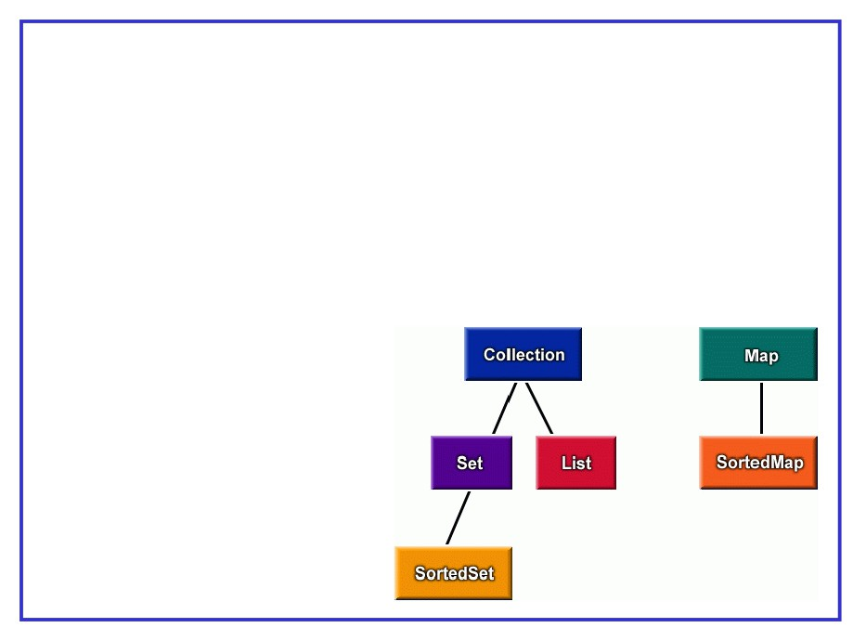
Collections
Basic operations of collections
▪ add objects to collection
▪ remove objects from collection ▪ search for an object in collection ▪ retrieve object from collection ▪ iterate through collection
Confidential
127

Slide 128

Collections
interface java.util.Collection
▪ root interface in the collections hierarchy ▪ extended by List, Set, Queue
▪ methods
boolean add(Object)
boolean remove(Object)
boolean addAll(Collection)
boolean removeAll(Collection) Object[ ] toArray( )
boolean contains(Object) Iterator iterator( )
int size( )
Confidential
128

Slide 129

Collections
interface java.util.List
▪ represents ordered collection ▪ allows duplicates
▪ implemented by ArrayList, Vector, LinkedList ▪ additional methods
void add(int index, Object) Object set(int index, Object) boolean remove(int index)
boolean addAll(int index, Collection) Object get(int index)
ListIterator listIterator( )
Confidential
129

Slide 130
Collections
interface java.util.Set
represents ordered collection duplicates not allowed extended by SortedSet
Confidential
130

Slide 131
Collections
interface java.util.Map
▪ represents key-value pairs
▪ Not part of Collection hierarchy ▪ extended by SortedMap
▪ implemented by HashTable, HashMap ▪ methods
boolean containsKey(Object key)
boolean containsValue(Object value) Object get(Object key)
Set[ ] keySet( )
Collection values( )
Object put(Object key, Object value)
Object remove(Object key)
Confidential
131

Slide 132
Collections
Classes
▪ ArrayList : Resizable array implementation of List Implements RandomAccess interface
▪ Vector :
Same as ArrayList but threadsafe (legacy class) Linked list implementation of List
▪ LinkedList :
provides add, remove at beginning or end Unsorted, unordered implementation of Set uses hashCode( )
▪ HashSet :
▪ LinkedHashSet : ordered version of HashSet
▪ TreeSet : ▪ HashMap : ▪ Hashtable : ▪ TreeMap :
implementation of SortedSet (elements sorted) unsorted Map implementation
same as HashMap but threadsafe (legacy class) implementation of SortedMap
Confidential 132

Slide 133
Collections
java.util.Iterator interface
Improvement over Enumerator to scan through collection
Methods
boolean hasNext( ) Object next( )
void remove( )
Confidential
133

Slide 134
Collections
points to note
▪ for sorting & searching , the class of objects should implement
java.lang.Comparable interface
▪ this interface provides single method int compareTo(T)
▪ java.util.Comparator interface can be used to create multiple comparisons
▪ Comparator provides compare( ) and equals( ) methods
▪ binary search returns index of the element for success, for failue it returns index at which the object can be inserted (-ve starting with -1 )
▪ collection / array should be pre-sorted for search
▪ Same comparison should be used for sorting and searching
Confidential
134

Slide 135
Collections
example - sorting collections
import java.util.*;
class TestSort1 {
public static void main(String[] args) {
ArrayList<String> stuff = new ArrayList<String>(); stuff.add("Denver");
stuff.add("Boulder"); stuff.add("Vail"); stuff.add("Aspen");
System.out.println("unsorted " + stuff); Collections.sort(stuff);
System.out.println("sorted " + stuff); }
}
Confidential 135

Slide 136
Collections
example - implementing Comparator
class EmpNoComp implements Comaparator<Employee> { public int compare(Employee a, Employee b){
return a.getEmpno( ) - b.getEmpNo( ); }
}
class NameComp implements Comaparator<Employee> { public int compare(Employee a, employee b){
return a.getName().compareTo( b.getName( ) ); }
}
……….
List <Employee> e = new ArrayList<Employee> ( ); …………
Collections.sort(e, new EmpNoComp( ) ); Collections.sort(e, new NameComp( ) );
Confidential
136

Slide 137
IO Streams
x
Confidential
137

Slide 138

Streams
• Java programs perform I/O through streams. A stream is:
- an abstraction that either produces or consumes information
- linked to a physical device by the Java I/O system
• All streams behave similarly, even if the actual physical devices to which they are linked differ
• Thus the same I/O classes can be applied to any kind of device as they abstract the difference between different I/O devices
Confidential
138

Slide 139

Streams
• Java’s stream classes are defined in the java.io package
• Java 2 defines two types of streams:
- byte streams
- character streams
• Byte streams:
- provide a convenient means for handling input and output of bytes
- are used for reading or writing binary data
• Character streams:
- provide a convenient means for handling input and output of characters
- use Unicode, and, therefore, can be internationalized
Confidential
139

Slide 140
Sets of I/O Classes
• The java.io package contains a collection of classes that support reading and writing from streams.
• A program needs to import the java.io package to use these classes.
• The stream classes are divided into two class hierarchies based on the data type on which they operate:
- Byte streams
- Character streams
Confidential
140

Slide 141
How to Do I/O
•import java.io.*;
- Open the stream.
- Use the stream (read, write, or both).
- Close the stream.
Confidential
141

Slide 142
Byte I/O Streams
• InputStream
- FileInputStream
- PipedInputStream
- FilterInputStream
- …
• OutputStream
- FileOutputStream
- PipedOutputStream
- FilterOutputStream
- ...
Confidential
142

Slide 143
InputStream
•The methods in the InputStream class include:
- read()
- read(byte b[])
- read(byte b[], int off, int len)
- skip(long n)
- available()
- close()
- mark(int readlimit)
- reset()
- markSupported()
Confidential
143

Slide 144
OutputStream
•The methods in the OutputStream class include:
- write(int b)
- write(byte b[])
- write(byte b[],int off int len)
- flush()
- close()
Confidential
144

Slide 145
Using Byte Streams
- Byte streams should only be used for the most primitive I/O.
- They are important because all other streams are built on byte streams.
- There are many byte stream classes.
- FileInputStream and
FileOutputStream are examples of file I/O byte streams.
Confidential
145

Slide 146
Character I/O Streams
• Reader
- BufferedReader
LineNumberInputStream
- CharArrayReader
- InputStreamReader
- FileReader
• Writer
- BufferedWriter
- CharArrayWriter
- OutputStreamWriter
- FileWriter
Confidential
146

Slide 147
InputStreamReader
- Is a character input stream that uses a byte input stream as its data source
- Reads bytes from a specified
InputStream and translates them into
Unicode characters, according to a particular platform- and locale-dependent character encoding
- Has a getEncoding() method that
returns the name of the encoding being used to convert bytes to characters
Confidential
147

Slide 148
OutputStreamWriter
- Is a character output stream that uses a byte output stream as the destination for its data
- Translates characters into bytes according to a particular locale and/or platform-specific character encoding, and writes those bytes to a specified OutputStream
- Supports all the usual Writer methods
- Has a getEncoding() method that
returns the name of the encoding being used to convert characters to bytes
Confidential
148

Slide 149
Standard Output
System.out.println():
- System is a class in the java.lang package.
- out is a public final static (class) variable.
• Declared as a PrintStream object reference
- println() is an overloaded method of the PrintStream class.
• PrintStream is a FilterOutputStream that subclasses OutputStream.
Confidential
149

Slide 150
PrintStream and PrintWriter
- Stream objects that implement formatting are instances of either PrintStream or PrintWriter.
- PrintStream:
• Is a byte stream class and a subclass of
(Filter)OutputStream
• Converts Unicode to environment byte encoding
• Terminates lines in a platform-independent way
• Flushes the output stream
- PrintWriter:
• Is a character stream class and a subclass of Writer
• Implements all of the print methods found in
PrintStream
• Only flushes when a println() method is invoked
Confidential
150

Slide 151
Data Streams
- Support binary I/O of values of primitive data types (boolean, char, byte, short, int, long, float, and double) as well as string values
- Implement either the DataInput interface or the DataOutput interface
Confidential
151

Slide 152
Object Streams
- Support I/O of objects
- Are implemented by the
ObjectInputStream and
ObjectOutputStream classes
- Implement all the primitive data I/O methods covered in data streams
- Can contain a mixture of primitive and object values
Confidential
152

Slide 153
Object Serialization
•Serialization is a lightweight persistence mechanism for saving and restoring streams of bytes containing primitives and objects.
•A class indicates that its instances can be serialized by:
- Implementing the java.io.Serializable or java.io.Externalizable interfaces
- Ensuring that all its fields are serializable, including other referenced objects
- Using the transient modifier to prevent fields from being saved and restored
Confidential
153

Slide 154
Threads
x
Confidential
154

Slide 155
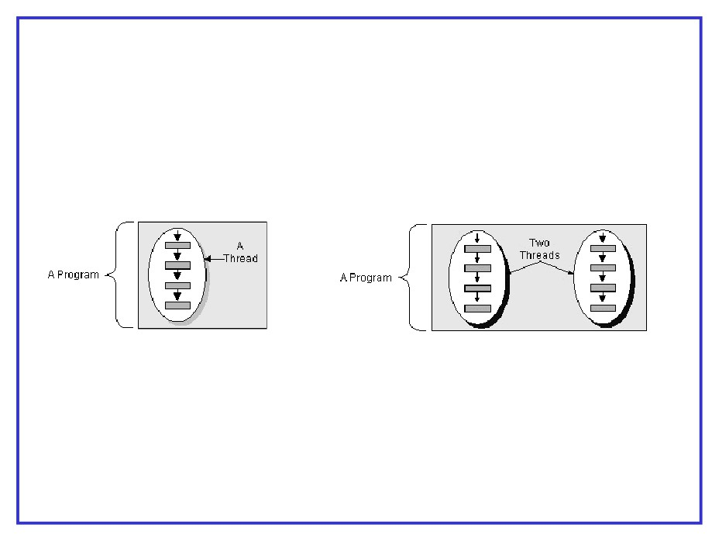
Threads
A thread is a single sequential flow of control within a program
Confidential
155

Slide 156

Threads - example 1
public class SimpleThread extends Thread { public SimpleThread(String str) {
super(str);
}
public void run() {
for (int i = 0; i < 10; i++) { System.out.println(i);
try {
sleep((long)(Math.random() * 1000)); } catch (InterruptedException e) {} }
System.out.println("DONE! “);
}
Activating the thread
SimpleThread tt = new SimpleThread(“thread 1”); tt.start();
}
Confidential 156

Slide 157

Threads - example 2
public class SimpleThread implements Runnable { String name ;
public SimpleThread(String str) { name = str;;
}
public void run() {
for (int i = 0; i < 10; i++) { System.out.println(i);
try {
sleep((long)(Math.random() * 1000));
Activating the thread
SimpleThread st = new SimpleThread(“Thread 1”); Thread tt = new Thread(st);
tt.start();
}
Confidential
157

Slide 158
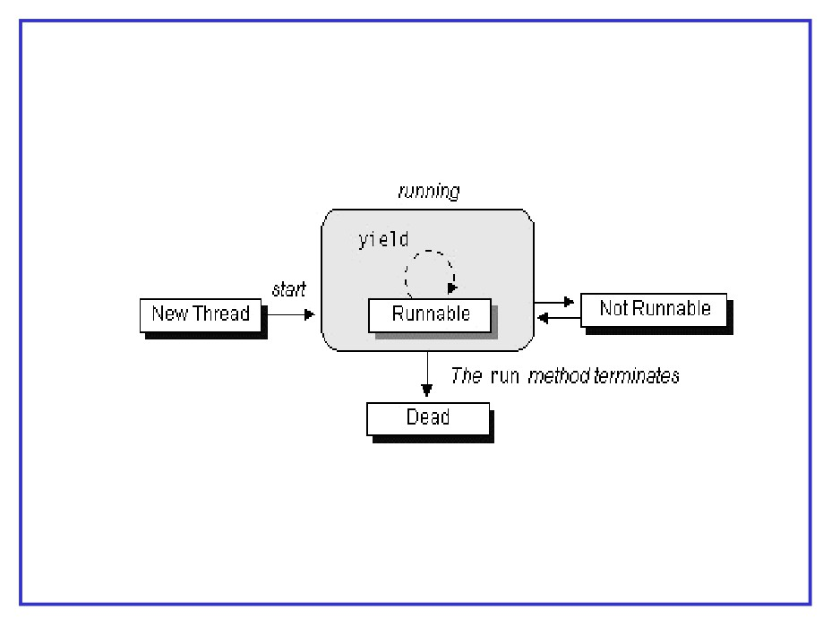
Life cycle of Threads
Confidential
158

Slide 159
AWT and SWING
x
Confidential
159

Slide 160

AWT
• Stands for Abstract Window Toolkit.
• First generation windowing, graphics and user interface toolkit for Java.
• Acted as a thin abstraction layer over the platform’s native user interface.
• GUI written using AWT will change its
appearance to use the native platform’s look and feel.
Confidential
160

Slide 161
Swing
• Second generation windowing toolkit for Java.
• Draws its own widgets and user interface elements instead of relying on the native windowing system.
• Has a greater amount of features and capabilities than AWT at the cost of performance, complexity, and steeper learning curve.
• Has the ability to alter its look-and-feel
independent of the underlying native windowing system.
Confidential
161

Slide 162
A Simple Frame
package sef.module14.sample;
import javax.swing.JFrame; import javax.swing.JLabel; import java.awt.Container;
public class SimpleJFrame extends JFrame{ private JLabel firstLabel;
public SimpleJFrame(){
firstLabel= new JLabel("First");
Container pane = getContentPane(); pane.add(firstLabel );
setLocation(300,300); setSize(100,100); setVisible(true);
}
public static void main(String arg[]){
SimpleJFrame frame = new SimpleJFrame();
Confidential
162
} }

Slide 163

Swing Imports
• The following two lines import two classes from the Swing library for use in our application.
import javax.swing.JFrame; import javax.swing.JLabel;
• JFrame represents a top level (can exist without a parent
container) window container with a few preset features and functionalities, such as a title bar, an icon, and minimize/maximize/close buttons.
• JLabel is a simple component for displaying text.
Confidential
163

Slide 164

Using Layouts Managers
• Swing containers use Layout Managers to determine the position and dimension of the components inside a container.
• Each layout is represented as a class.
• To set the layout manager of a container, pass the instance of a layout manager class as a parameter to a container’s setLayout() method.
Confidential
164

Slide 165
Setting the Layout Manager
• The following modifications to the previous example will set the layout manager to use FlowLayout.
Container pane = getContentPane();
FlowLayout flowLayout = new FlowLayout(); pane.setLayout(flowLayout);
• The FlowLayout manager arranges components in a series from left to right, top to bottom.
• Modify the code to set the layout and add two more components.
Confidential
165

Slide 166

Using BorderLayout
• The BorderLayout Manager divides the container into 5 distinct zones named NORTH, SOUTH, EAST, WEST and CENTER.
• When a component is added to the container, the code must also specify where the component is to be placed.
• The size of the component added will depend on the dimensions of the container.
• BorderLayout is the default Layout of the JFrame content pane.
Confidential
166

Slide 167
Combining Layouts
• The JPanel class is a container that is designed to be placed inside other containers.
• JPanels can set their own layouts
independently from the parent container layout.
• JPanels can be placed inside other JPanels.
Confidential
167

Slide 168

Event Handlers
• Event handlers are used to add interactivity to GUIs.
• All components are event sources that generate events like mouse clicks and movement, keyboard input, etc.
• Event listeners/handler are objects that want to be
informed of events generated by event sources and execute behavior when an event is generated.
• Event listeners are interfaces that are implemented by classes.
• Each listener interface represents different possible kinds of events.
Confidential
168

Slide 169
Commonly Used Event Listeners
• ActionListener - Listens for ActionEvents such as button clicks, text field entries, menu selections.
• KeyListener - Listens for key strokes.
• MouseListener - Listens for MouseEvents such as mouse clicks, presses, and releases. Mostly used for pop-up menus.
• MouseMotionListener - Listens for mouse movements.
• ChangeListener - Listens for changes occurring in
components, such as sliders, progress bars, and spinners.
• WindowListener - Listens for WindowEvents, such as window closing, focusing, iconifying, etc.
Confidential
169

Slide 170

Registering Listeners
• Identify the components that will act as the source of the events.
• Identify the kind of events that these components might generate in order to determine what kind of listener interfaces to use.
• Implement the listener methods.
• Register an instance of the event handler classes to the appropriate event source
Confidential
170

Slide 171

Using Anonymous Inner Classes
• No need for listener interface to be implemented by main class.
• ActionListener is implemented inside addActionListener().
• Unlike the previous example, there is no need to identify the event source.
Confidential
171

Slide 172

JDBC
x
Confidential
172

Slide 173
java.sql package
Driver
DriverManager DriverPropertyInfo
ResultSet
SQLException SQLWarning
Connection
DatabaseMetaData ResultSetMetaData
Statement
PreparedStatement
Confidential
173

Slide 174
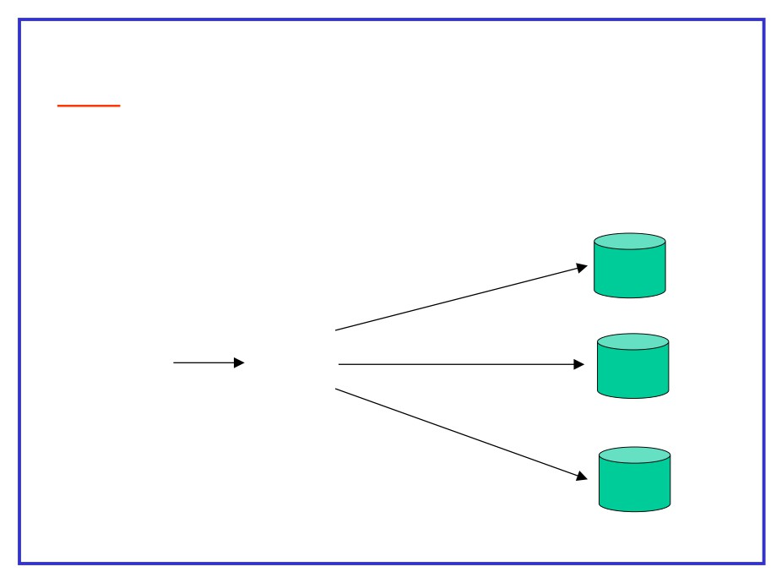
Classification of JDBC Drivers
Type 1
JDBC-ODBCBridge
Lets java database clients talk to databases via ODBC drivers
ODBC
SQL
Driver
Server
Java JDBC
database ODBC
ODBC
Oracle
client Bridge
Driver
ODBC
DB2
Driver
Confidential
174

Slide 175
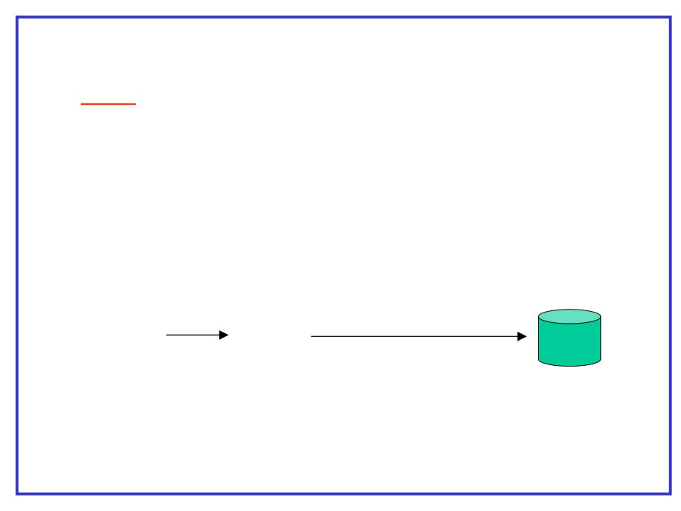
Classification of JDBC Drivers (continued)
Type 2
Native- API partly java driver :
- Consists of drivers that talk to servers in their native protocols
- Must be installed in the client machine
Java Type 2
database JDBC
Vendor specific protocol
client driver
( java & binary code )
Database
servere
Confidential
175

Slide 176
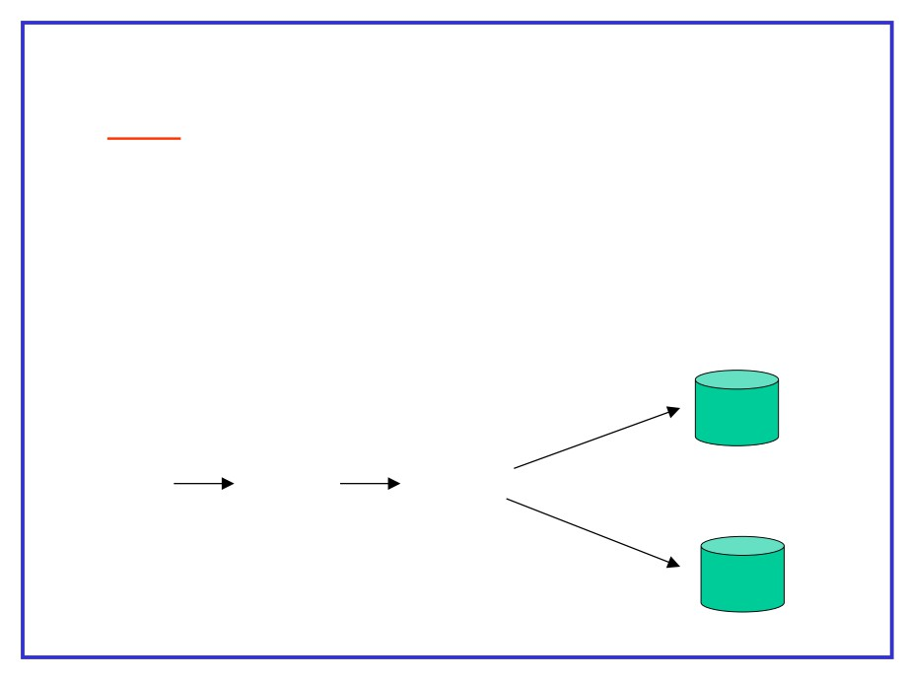
Classification of JDBC Drivers (continued)
Type 3
JDBC-Net pure Java driver
- Consists of drivers that speak standard network protocol ( such as http ) to a database access server
- database access server translates the network protocol to vendor specific database protocol
SQL
Server
Java
Type 3
JDBC
Database
database
access
driver ( pure java )
client
server
DB2
Confidential 176

Slide 177
Classification of JDBC Drivers (continued)
Type 4
Native protocol pure java driver :
Consists of driver that speaks the vendor specific protocol of the database server that it is designed to interface with
Java Type 4
database JDBC
Vendor specific protocol
client driver
( pure java )
Database
servere
Confidential
177

Slide 178

DriverManager class
All methods are static and the class does not have a constructor
Methods
Connection getConnection( String url )
Connection getConnection( String url , String user , String password )
Confidential
178

Slide 179

Connection class
Methods
Statement createStatement( )
PreparedStatement prepareStatement( String sql ) void close ( )
DatabaseMetaData getMetaData( )
void setAutoCommit( boolean commit )
// default true
boolean getAutoCommit( )
void commit( )
void rollback( )
Confidential
179

Slide 180

Setting up database connection
Class.forName( “sun.jdbc.odbc.JdbcOdbcDriver” )
Connection con = DriverManager.getConnection( url )
URL format
jdbc: <sub protocol > : <subname related to database>
example
jdbc : odbc : student
jdbc : ids : //www.test.com:90/conn?dbtype=odbc&dsn=student
Confidential
180

Slide 181

Statements
types of statements
- Statement
- PreparedStatement
All these are implemented as classes
Confidential
181

Slide 182
Statement interface
Methods
ResultSet executeQuery( String query ) int executeUpdate( String sql ) boolean execute( String sql) ResultSet getResultSet ( ) int getUpdateCount( )
Confidential
182

Slide 183
Example code for Statement
Statement stmt ;
private void runStatement() throws SQLException {
Class.forName ("jdbc.odbc.JdbcOdbcDriver");
Connection con = DriverManager.getConnection(“jdbc:odbc:dsn” ); String sql = ”select name , salary from emp where empno = 3010 ” ;
stmt = con.createStatement( ) ;
ResultSet rs = stmt.executeQuery( sql ) ;
}
Confidential
183

Slide 184

PreparedStatement
Runtime parameters can be supplied to a prepared statement
Methods
ResultSet executeQuery( ) int executeUpdate() boolean execute( )
ResultSet getResultSet ( ) int getUpdateCount( )
void setString( int parameterindex , String x )
void setBoolean( int parameterindex , boolean x )
void setInt( int parameterindex , int x )
void setFloat( int parameterindex , float x )
void setDate( int parameterindex , java.sql.Date x )
void clearParameters( )
Confidential 184

Slide 185
Example code for PreparedStatement
PreparedStatement prepStmt ;
private void runPreparedStatement() throws SQLException {
Class.forName ("jdbc.odbc.JdbcOdbcDriver");
Connection con = DriverManager.getConnection(“jdbc:odbc:dsn” ); String stmnt = "SELECT name,salary from emp where empno = ? ” ;
prepStmt = con.prepareStatement( stmnt ) ;
prepStmt.setInt( 1 , 3104 ) ;
ResultSet rs = prepStmt.executeQuery( ) ;
}
Confidential
185

Slide 186

ResultSet interface
Methods
boolean next( )
void close(
)
boolean wasNull( )
boolean getBoolean ( int columnindex ) int getInt ( int columnindex )
String getString ( int columnindex )
float getFloat ( int columnindex )
ResultSetMetaData getMetaData( )
boolean getBoolean ( String columnname ) String getString ( String columnname ) int getInt ( String columnname )
Confidential
186

Slide 187

ResultSetMetaData interface
Methods
int getColumnCount( )
String getColumnName( int columnindex )
int getColumnType( int columnindex )
String getColumnTypeName ( int columnindex ) String getTableName ( int columnindex )
Confidential
187

Slide 188
Java 5 features
x
Confidential
188

Slide 189

static imports
• Used to import static members of a class
• After import they can be referred directly
eg :
import static java.lang.System.out; import static java.lang.Integer.*; public class TestStaticImport {
public static void main(String[] args) { out.println(MAX_VALUE);
out.println(toHexString(42)); }
}
Confidential
189

Slide 190
enhanced for loop
• Specialized loop for array or collection
• similar to for-each in some languages
• format :
for(declaration : expression)
• declaration : newly created block variable whose type is compatible with the elements of the array
• expression : must evaluate to array or collection
Confidential
190

Slide 191
enhanced for loop
example
then
int a[ ]
= {10, 20, 30, 40, 50};
for(int i=0; i < a.length; i++)
System.out.println(a[i]);
now
int a[ ]
= {10, 20, 30, 40, 50} ;
for(int i
: a)
System.out.println(i);
Confidential
191

Slide 192
Var arg methods
▪ also known variable-arity method
▪ method is invoked with variable number of arguments ▪ Not as flexible as in C++
▪ format :
methodname(other parameters, <type> …<variable>)
▪ <variable> is implicitly an array
▪ variable argument should be at the end
▪ Overloading can be done (with no ambiguity)
Confidential 192

Slide 193
Var arg methods
▪ Example :
static void vaTest(int ... v) { for(int x : v)
System.out.print(x); }
static void vaTest(String s, int ... v) { System.out.println(s);
for(int x : v)
System.out.print(x ); }
public static void main(String args[]) {
vaTest(1,2);
vaTest(new int[]{4,5,6}); int b[] = {100,200,300}; vaTest("Hello", 1,2,3,4,5); vaTest("Hello",b);
vaTest();
}
Confidential
193

Slide 194
Var arg methods
Example
static void vaTest(int ... v) { }
static void vaTest(int s, int ... v) { // ambiguous }
static void vaTest(boolean … v) { }
public static void main(String args[]) {
vaTest();
//ambiguous method call
}
Confidential
194

Slide 195

Generics
Legacy way of using collections
legacy collections are not
creation
type safe
List myList = new ArrayList();
// can't declare a type
myList.add("Fred");
// OK, it will hold Strings
myList.add(new Dog()); // and it will hold Dogs too
myList.add(new Integer(42)); // and Integers...
retrieval
String s = (String) myList.get(0);
// goes fine
String s = (String) myList.get(1) ;
// OOPS !!! ClassCastException
Confidential
195

Slide 196
Generics
Generic collections (java 5)
creation
List<String> myList = new ArrayList<String>( ); // takes only Strings
myList.add("Fred");
// goes fine
myList.add(new Dog());
// No !! compiler does not allow
myList.add(new Integer(42)); // sorry again
retrieval
String s = myList.get(0);
// no casting required. Compiler knows it
Confidential
196

Slide 197
Generics
method parameters
Legacy
void checkAndRemove(Collection c) { String s = null;
for ( Iterator i = c.iterator( ); i.hasNext( ); ) { s = (String) i.next( );
if (s.length( ) > 4)
System.out.println(s); }
}
Generic
void checkAndRemove(Collection <String> c) { String s = null;
for ( Iterator<String> i = c.iterator( ); i.hasNext( ); ) { s = i.next( );
if ( s.length( ) > 4)
System.out.println(s); }
}
Confidential
197

Slide 198
Wrapper classes - Boxing/Unboxing
wrapper classes
☞ Designed to convert primitives into objects  Wrapper objects are immutable
☞ provide functions for conversion of primitives to/from String objects to different bases
☞ All wrapper class names map to primitives they represent except Integer and Character
☞ Byte, Short, Integer, Long, Float, Double are sub classes of Number  constructors overloaded to take primitives as well as their String representation
Confidential
198

Slide 199
Wrapper classes - Boxing/Unboxing
Methods of Number
byte byteValue( ) short shortValue( )
int
intValue( )
long
longValue( )
float
floatValue( )
double doubleValue( )
Character
char charValue( )
Boolean
boolean booleanValue( )
Confidential
199

Slide 200
Wrapper classes - Boxing/Unboxing
Similar Methods of Numeric wrappers
static xxx parseXxx(String)
convert String to primitive (only numerics) may throw NumberFormatException
static xxx parseXxx(String s, int radix)
overloaded method for integer family
String toString( )
static String toBinaryString( n ) static String toOctalString( n ) static String toHexString( n )
}
Only Integer & Long
Confidential
200

Slide 201

Wrapper classes - Boxing/Unboxing
Boxing / Unboxing
☞ Before Java 5, wrapping and unwrapping was done explicitly
☞ For example to perform arithmatic on a wrapped value involved unwrapping and re-wrapping after operation
Integer x = new Integer(45);
int y = x.intValue( );
y = y +10 ;
x = new Integer(y) ;
☞ java 5 provides auto boxing / unboxing
☞ In that wrapping and unwrapping done automatically based on the operation
Integer x = new Integer(45); x = x +10 ;
x++;
// and so on
Confidential
201

Slide 202
Wrapper classes - Boxing/Unboxing
All these are possible now !!!
Integer x = 36;
// wrap it
x++;
// unwrap and re-wrap
List l = new ArrayList();
l.add(0,36);
//wrap and add
Integer a = 30;
//wrap
Integer b = 20;
//wrap
Integer c = a + b;
//unwrap, add, wrap the sum
if (a.equals(30) )
//unwrap and compare
Confidential
202

Slide 203

Confidential
203

